Slide 1
WELCOME

Slide 2

TEAM NAME : TriCore Blaster
Domain: EMBEDDED
Project Name: SMART SCREEN
Theme: SMART DEVICES

Slide 3









Sponsored by

Slide 4
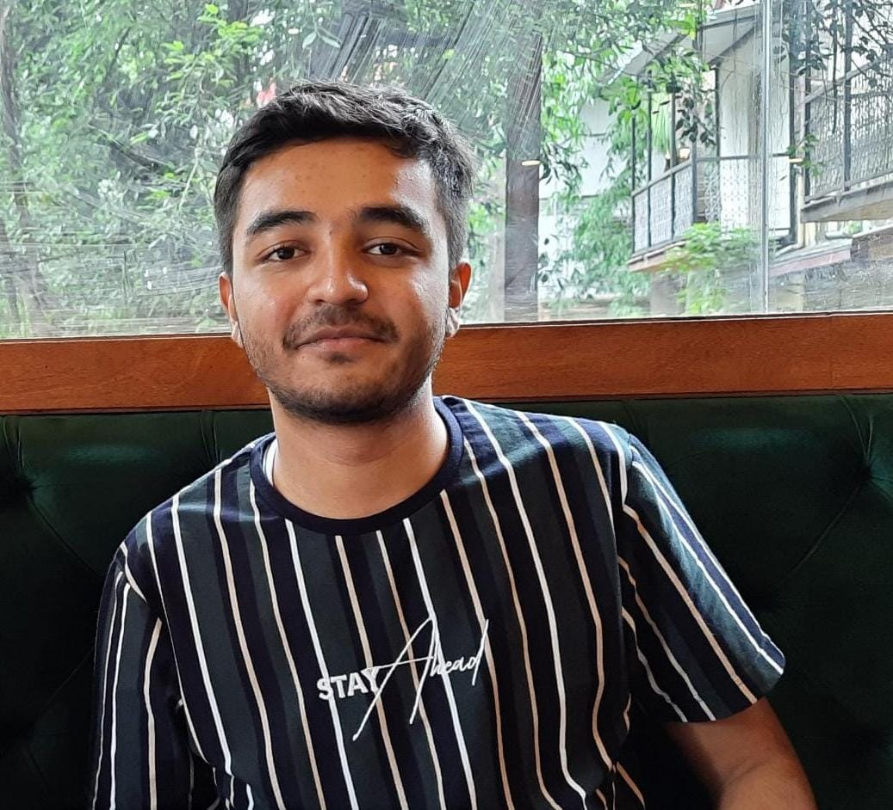
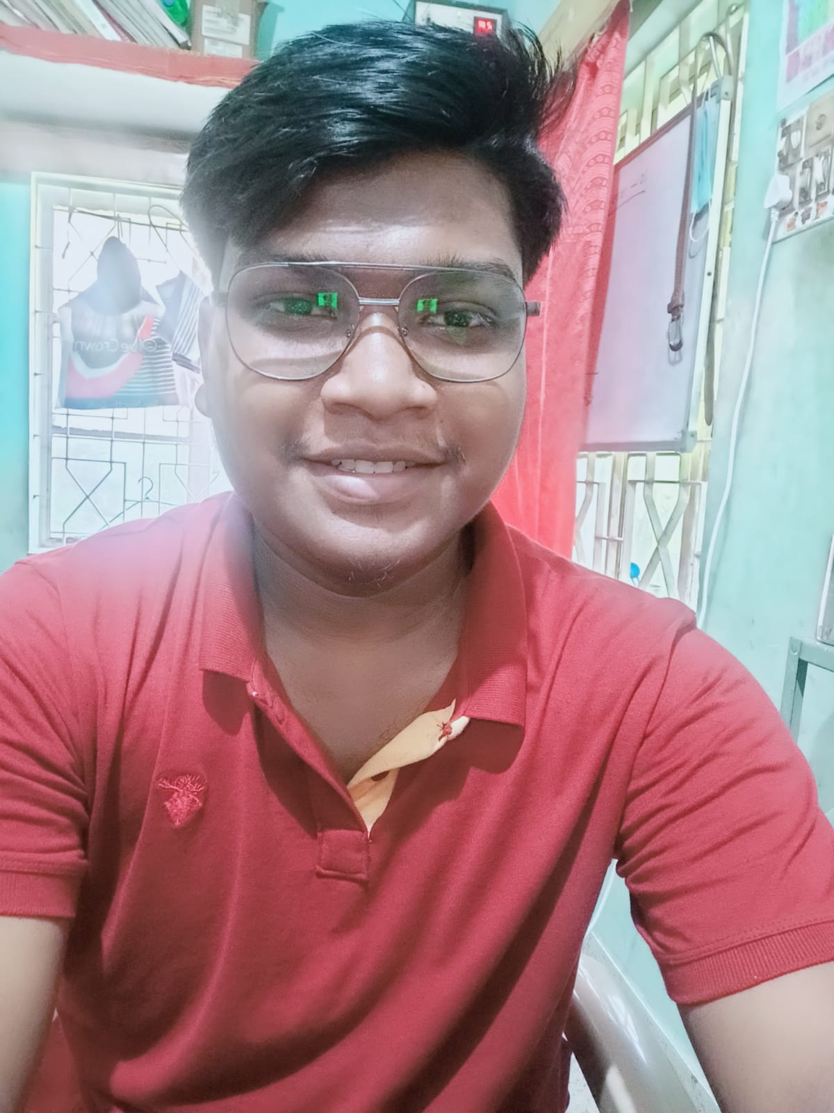
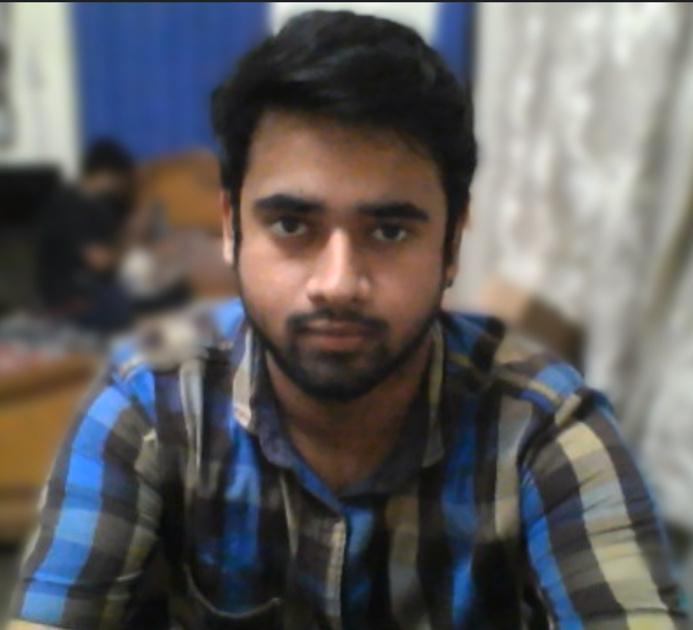
TEAM DETAILS
Team Member - 1:
Name: RITURAJ
Email Id: ritutajd.das007@gmail.com
Contact Number: 8550966167
Team Members - 2:
Name: AMIT SOREN
Email Id: btech10223.20@bitmesra.ac.in
Contact Number: 7294879980
Team Members - 3:
Name: NEELESH RANJAN
Email Id: btech10212.20@bitmesra.ac.in
Contact Number: 9470514719

Slide 5
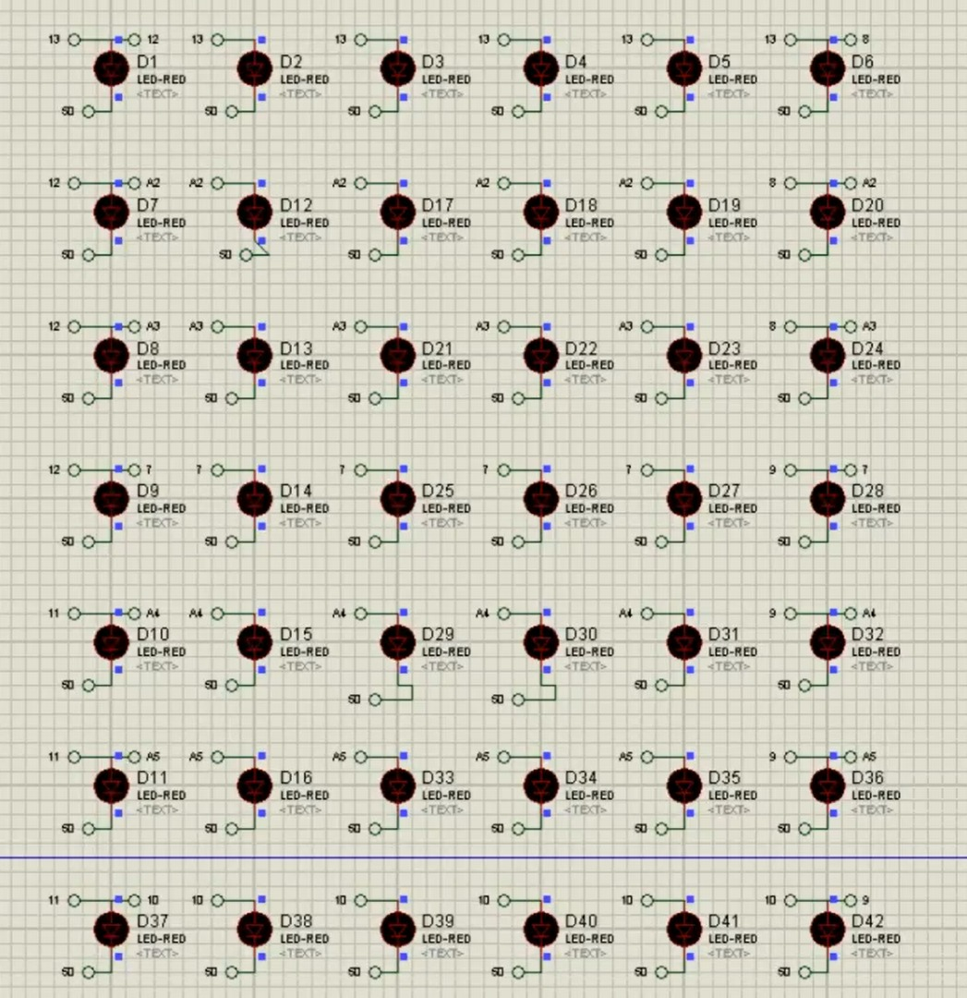
INTRODUCTION
The project name is “Smart Screen” and is based on the voice control and wireless technology via Bluetooth and can be operated with the help of mobile phone. By this project it is indicated that the wired technology has become out dated and it is the time to rely on the wireless devices and systems.
The project is basically a voice controlled wireless smart screen. The screen takes the voice as input and according to the input it displays the output on the screen. This will save the time of user and all the processes are little bit faster because the input is of the voice form. Also, it can be operated with the mobile phone via Bluetooth.

Slide 6
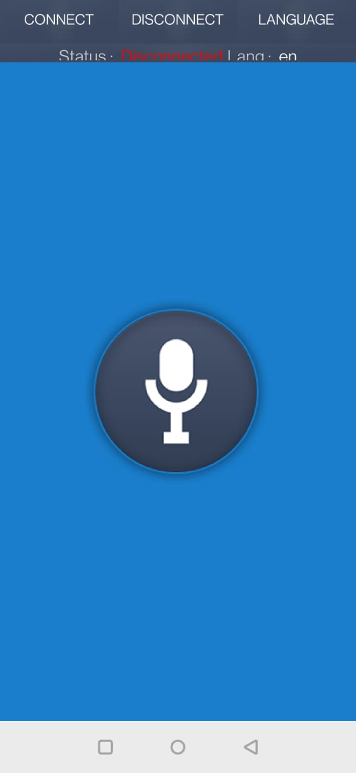
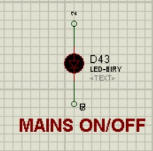
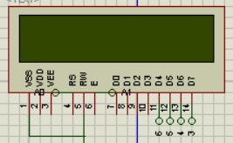
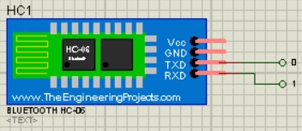
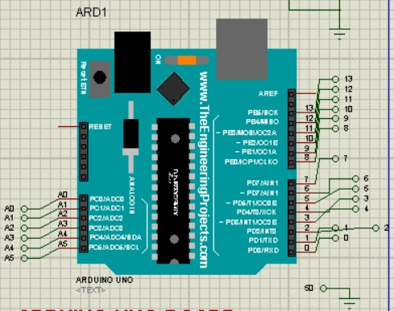
APPRATUS REQUIRED
ARDUINO UNO
BLUETOOH HC-06
LM016L- 16X2 LCD DISPLAY
RED-LED-42 no’s
GROUND
DEFALUTS
LED-BIRY-1 no.
COM Port- 3 - Incoming
Virtual Baud Rate – 9600

Slide 7
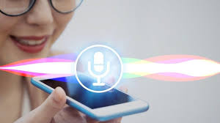
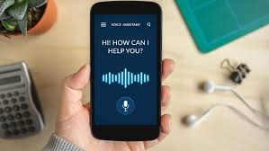
VOICE CONTROLLED &WIRELESS TECHNOLOGY

Slide 8
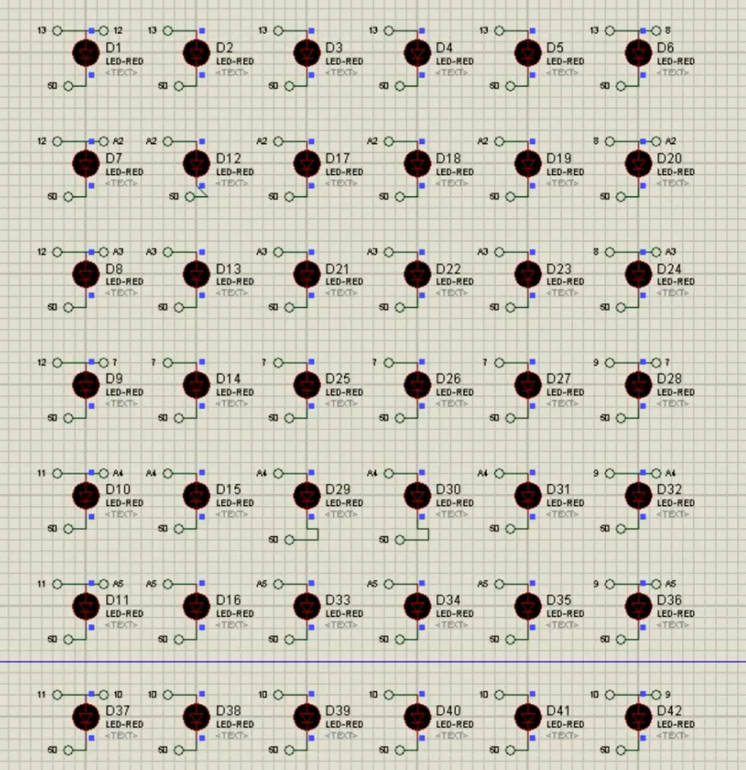
BLUETOOTH

Slide 9
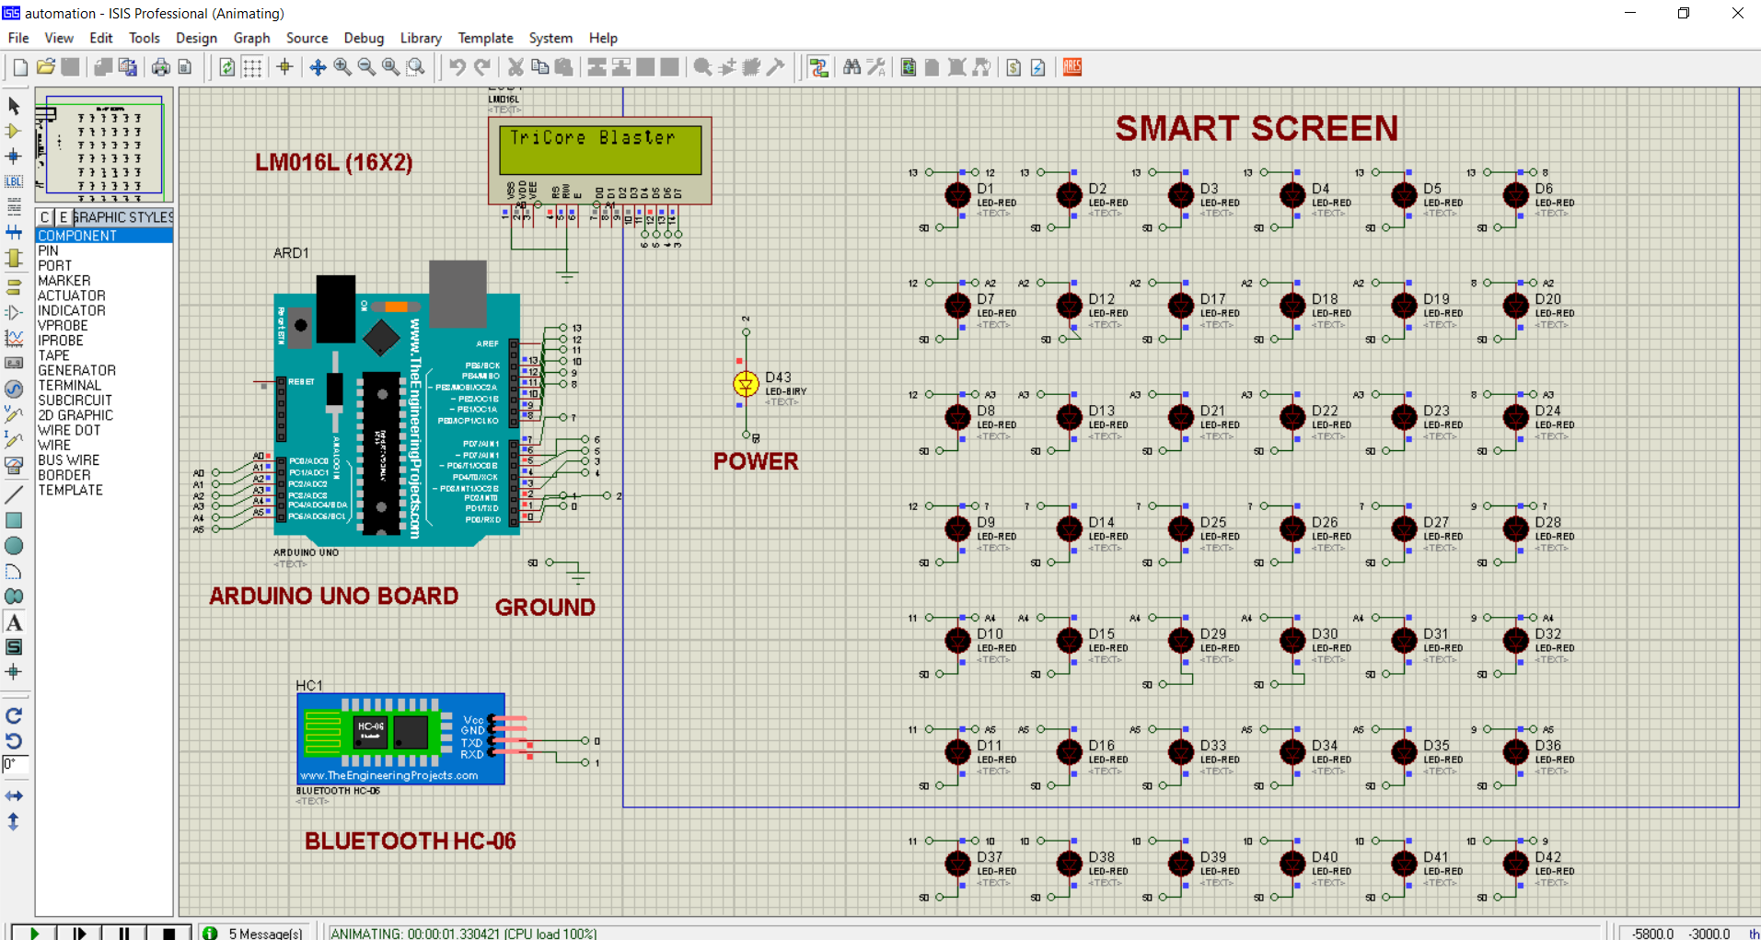
SIMULATION IMAGE

Slide 10
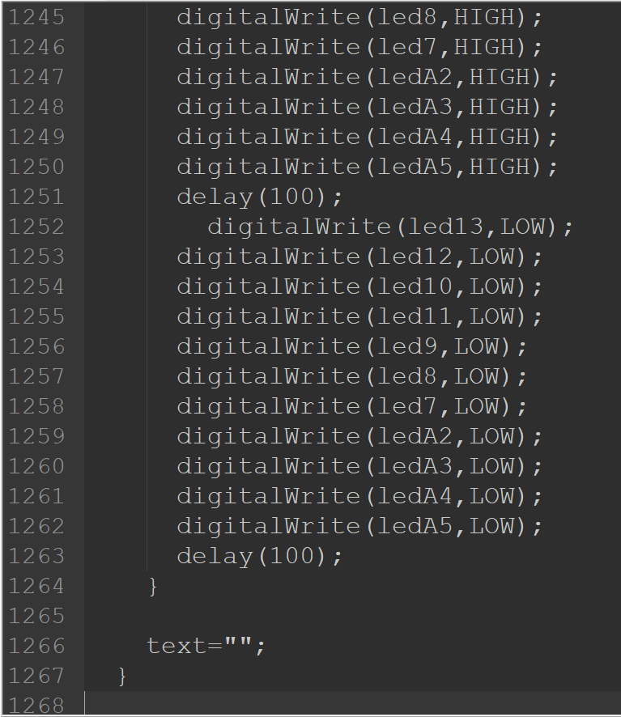
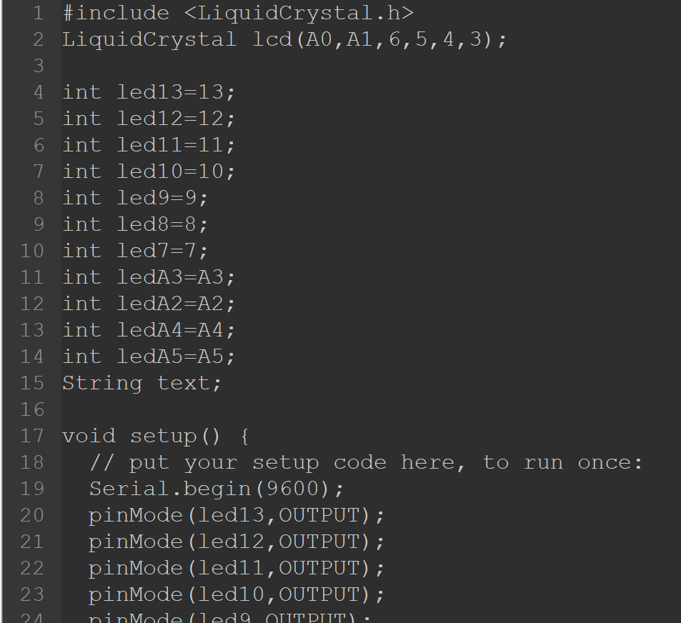
SOURCE CODE

Slide 11

APPLICABIITY OF THE PROJECT
Usability:
Displaying numbers, light on and off, displaying different patterns, single digit sum calculator, blinking lights.
The project is a voice controlled wireless device so will reduce the cost of wires and somewhat become cost effective.
Scalability:
This project can work in a large scale because it is completely wireless and voice controlled through mobile phones via Bluetooth.

Slide 12
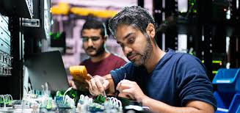
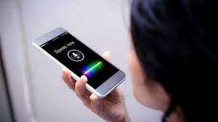
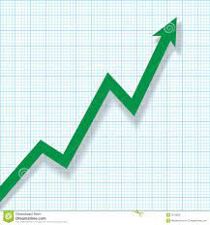
How Realistic to Achieve/Make:
This project can be easily made by using the hardware components used in the simulation and are easily available and cost effective. This project consists of all the basic components present in an Arduino kit.
Specify Features:
Voice controlled through google assistant, completely wireless, can be controlled through your mobile phone, has the range of that of the specified Bluetooth chip installed on the laptop and mobile phone. As the screen if of LED type so it is an power efficient device.
Economic Sustainability:
As state, this project is a cost effective one as it consists of all the basic components present in an Arduino kit and are easily available.

Slide 13

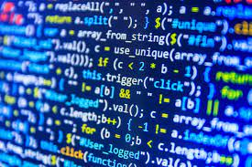
Environment Sustainability:
The project is an eco-friendly as there are no harmful components used that are harmful to the environment. Also, there are no wires are used so there is no waste generated.
Any Improvement in your project you foresee to implement in future:
The capability of this “Smart Screen” can be taken more and more by further coding the Arduino board and adding more lines to the present code in the way you want to display on the screen with voice control.

Slide 14
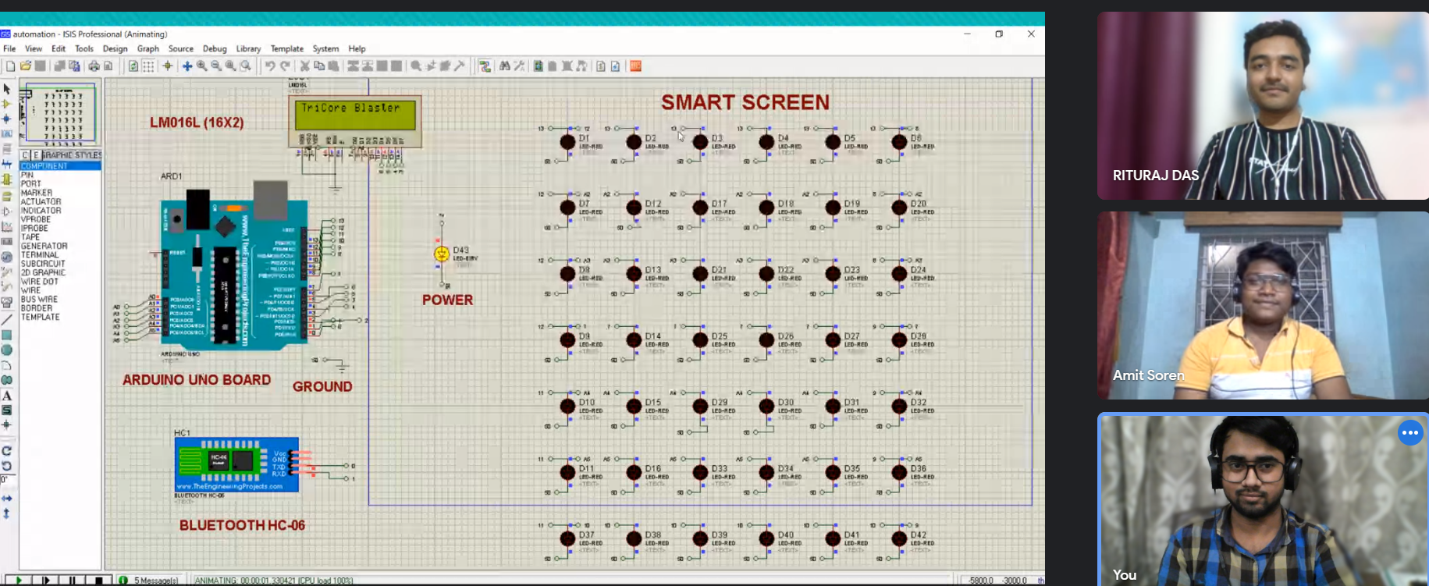
TEAM WORK

Slide 15
THANK YOU

